Slide 1
Equity, Ethics, and Evolution of Autism Treatment Through On-Demand Caregiver Support
Matthew T. Brodhead, Ph.D., BCBA-D
Assistant Professor
Michigan State University

Slide 2
Acknowledgements
Allison White
Emma Sipila-Thomas
David Ray Miranda
Holly Long
Alexandria Thomas
Dr. David Cox
Dr. Josh Plavnick
Dr. Marisa Fisher

Slide 3




Slide 4
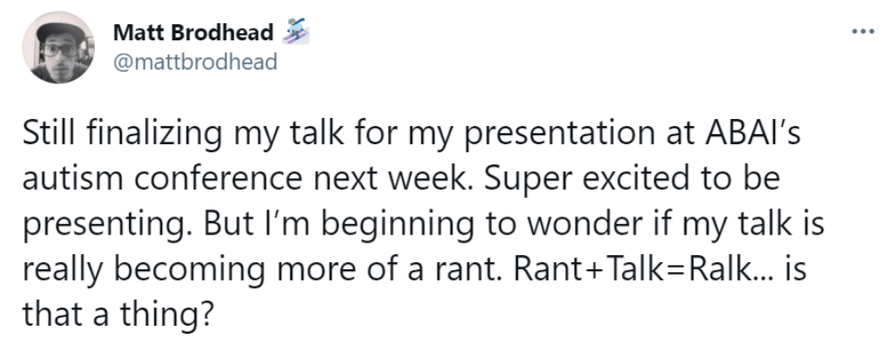


Slide 5
The COVID-19 Pandemic has asked the field of ABA to change the way it does business

Slide 6

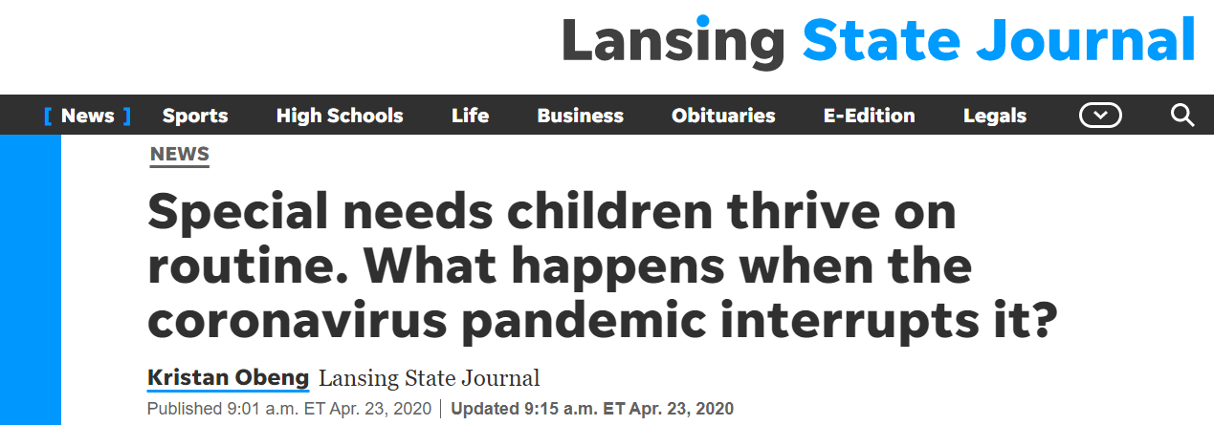
Challenges of COVID-19
COVID-19 has brought tremendous challenges to people with autism and their families.

Slide 7

Notes:
https://www.nwea.org/content/uploads/2020/05/Collaborative-Brief_Covid19-Slide-APR20.pdf

Slide 8
Challenges of COVID-19
People with autism are at greater risk of negative outcomes resulting from COVID-19 due to
  greater healthcare and mental health needs, as well as
  reliance on community-based services (Aishworiya & Kang, in press).
Recent research suggests that people with intellectual and developmental disabilities have the third highest risk of dying from COVID-19 (FAIR Health, 2020).

Slide 9
Caregivers are Tired
The majority of caregivers are not trained to use evidence-based supports (Unholz-Bowden et al., 2020) and are not adequately prepared to fill the role of a teacher's aide to support their child’s access to online instruction.
A recent study by Asbury et al. (in press) found caregivers experienced feelings of loss and worry, and displayed changes in their mood and behavioral patterns.

Slide 10
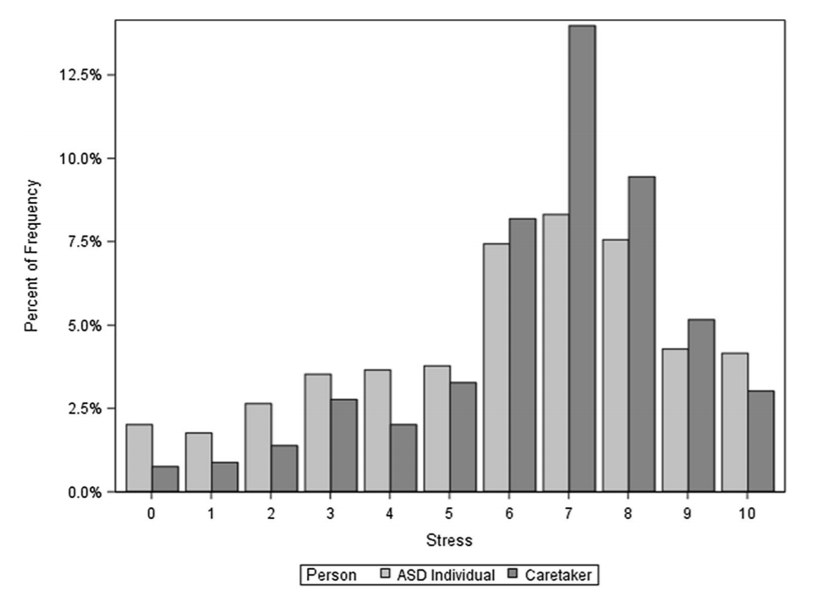
From Manning et al. (in press).
Notes:
https://link.springer.com/article/10.1007/s10803-020-04760-5#Tab2

Slide 11
A Problem of Design
Our systems are not designed to support families in a time of crisis (e.g., the COVID-19 pandemic).
For those who have had services (pre-pandemic),
  Reliance on in-person services
    Little foresight or vision in adaptive or dynamic models
  Reliance on models that are comprehensive vs focused behavioral interventions

Slide 12
Ethical Issues
During Phase 1 (see Migus et al., 2020) of the pandemic, the ethical surrounding the continuation or postponement of ABA services were incredibly complex.
  Little to no information about COVID-19, and testing and contact tracing infrastructure

Slide 13
Ethical Issues
BACB’s March 19, 2020 Guidance:
  “It is clear that the primary directive is to do no harm to clients.”
    Nonmaleficence
  Behavior analysts have a responsibility to operate in the best interest of clients (2.0)
  Behavior analysts put the client's care above all others (2.04d)

Slide 14

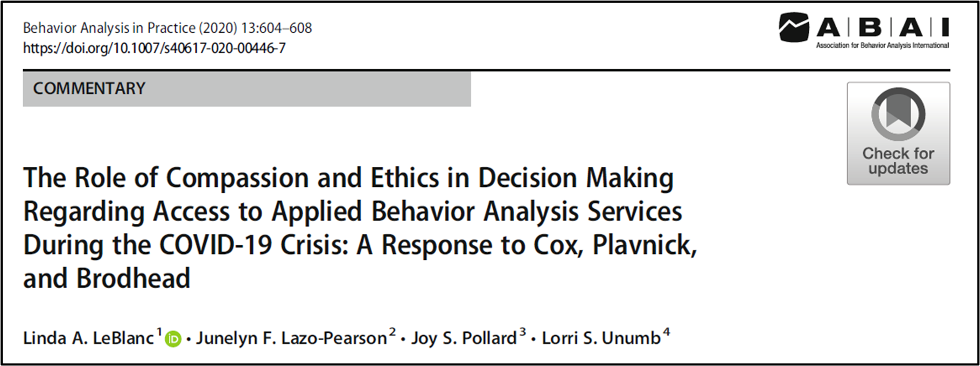

Slide 15
Summary
COVID-19 has a major impact on people with autism and their families.
Traditional modalities (i.e., face-to-face) for providing ABA services directly conflict with public health guidelines.
Ethical charge to “do no harm” is incredibly complex as “harm” can be characterized in multiple different ways.

Slide 16
One solution: a case study in caregiver support

Slide 17
Facilitating Effective Learning and Therapy
One recommendation, in response to COVID-19, is to “accommodate children with developmental disabilities with targeted strategies to address their difficulties” (Aishworiya & Kang, in press, p. 3).

Slide 18
Spartan Caregiver Support
Spartan Caregiver Support began in early April, 2020 in response to Governor Whitmer’s Stay-at-Home Order.
Purpose: to help caregivers address social or behavioral challenges through phone or video-chat technology.

Slide 19
Spartan Caregiver Support
The following data reflect outcomes between April 1 and June 1, which reflects most of the time Michigan’s Stay-at-Home Order was in effect.
The project is still ongoing.

Slide 20
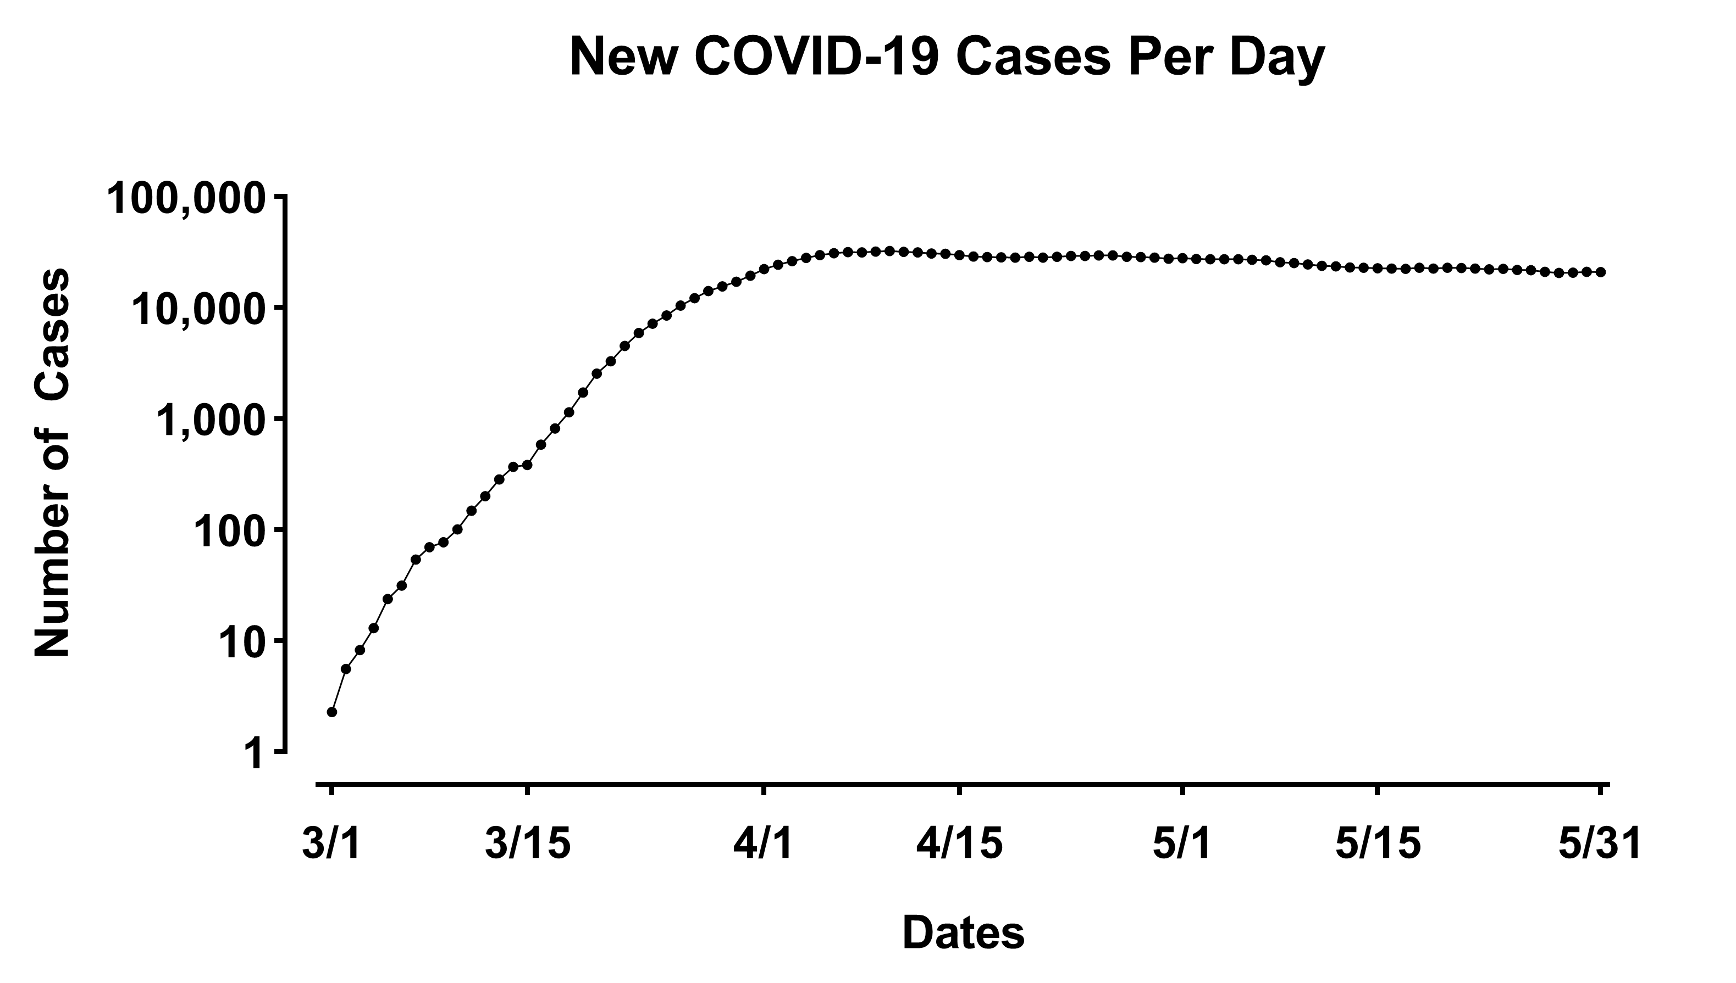

Slide 21
Support Provided
We provide free focused support in the following areas:
  Behavioral concerns, such as tantrums and meltdowns
  Communication difficulties, such as difficulty expressing wants and needs
  Daily schedules and routines, such as completing a list of chores and brushing one’s teeth
  Sleep concerns, if those concerns have a behavioral (and not a medical) cause
  Getting along with family members, such as siblings and cousins
  Following rules and expectations, such as following a caregiver’s instructions

Slide 22
Repertoire of Problem Solving
The brief nature of our interactions required a certain set of skills to quicky
  Identify the problem
  Generate a potential solution
  Seek caregiver feedback on feasibility
  Provide written notes and suggestions to guide caregiver implementation
Ethically justifiable given the circumstances

Slide 23
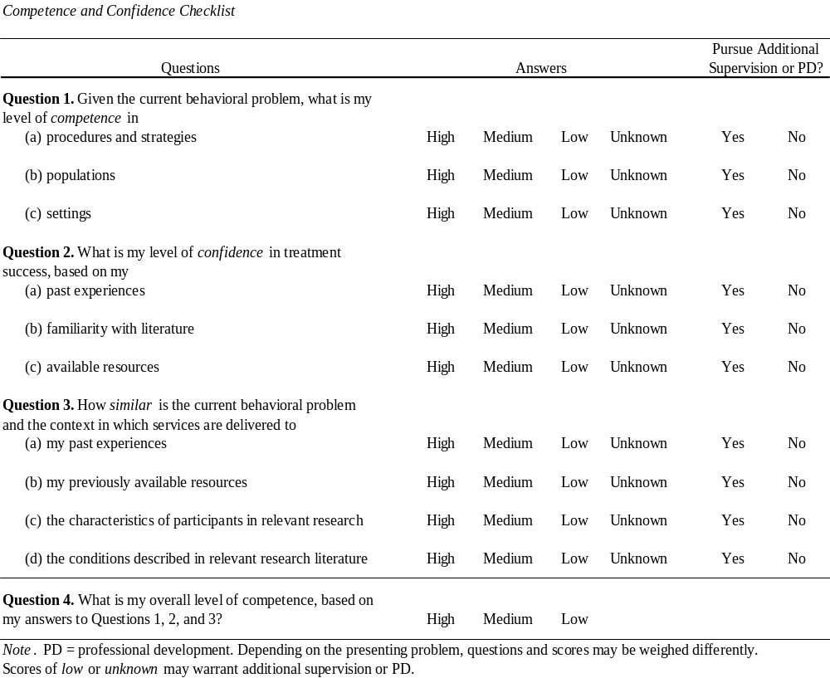
Brodhead et al. (2018)

Slide 24
Liabilities
Though our program is primarily designated as “service” oriented, we have standing approval from MSU’s IRB to conduct our work under the umbrella of research (9.02).
  Provides protections to caregivers as active participants in human subjects research.
Through our roles at MSU, we are mandated reporters, also providing protections to children being cared for by caregivers (9.01).

Slide 25
Recruitment
Visit program Web Site
Sign up for listserv
Receive weekly e-mails with scheduling information
Schedule meeting
Follow-up recommendations
and notes
Have meeting

Slide 26
Participants and Setting
Participants: 17
  Reside within State of Michigan
  Over age 18
  Caregiver of person with autism (broadly defined)
  Most families were not currently receiving ABA services
Setting: Zoom

Slide 27
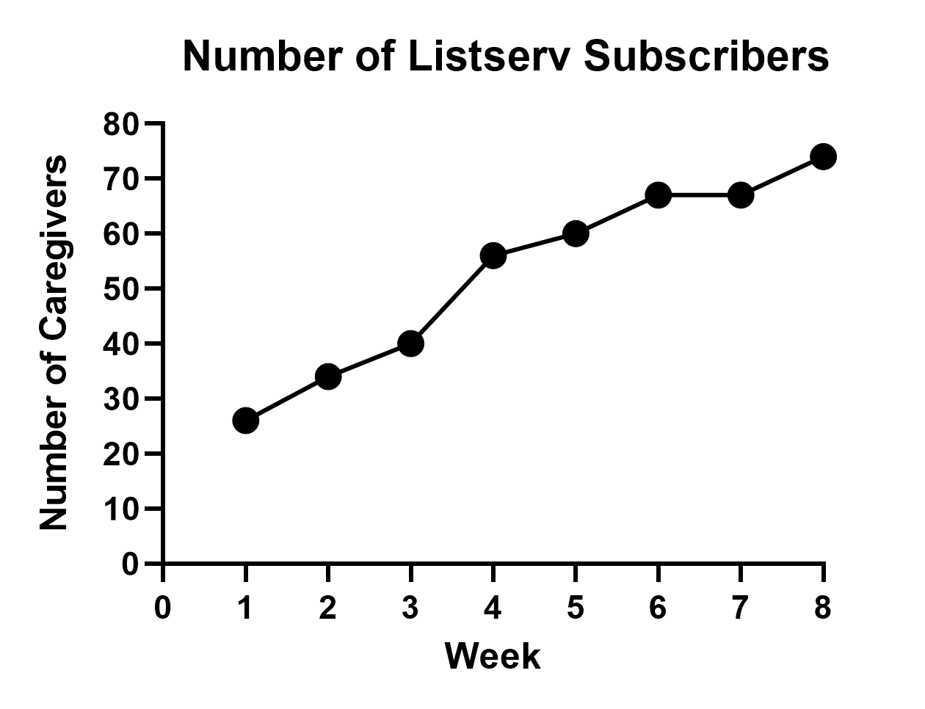
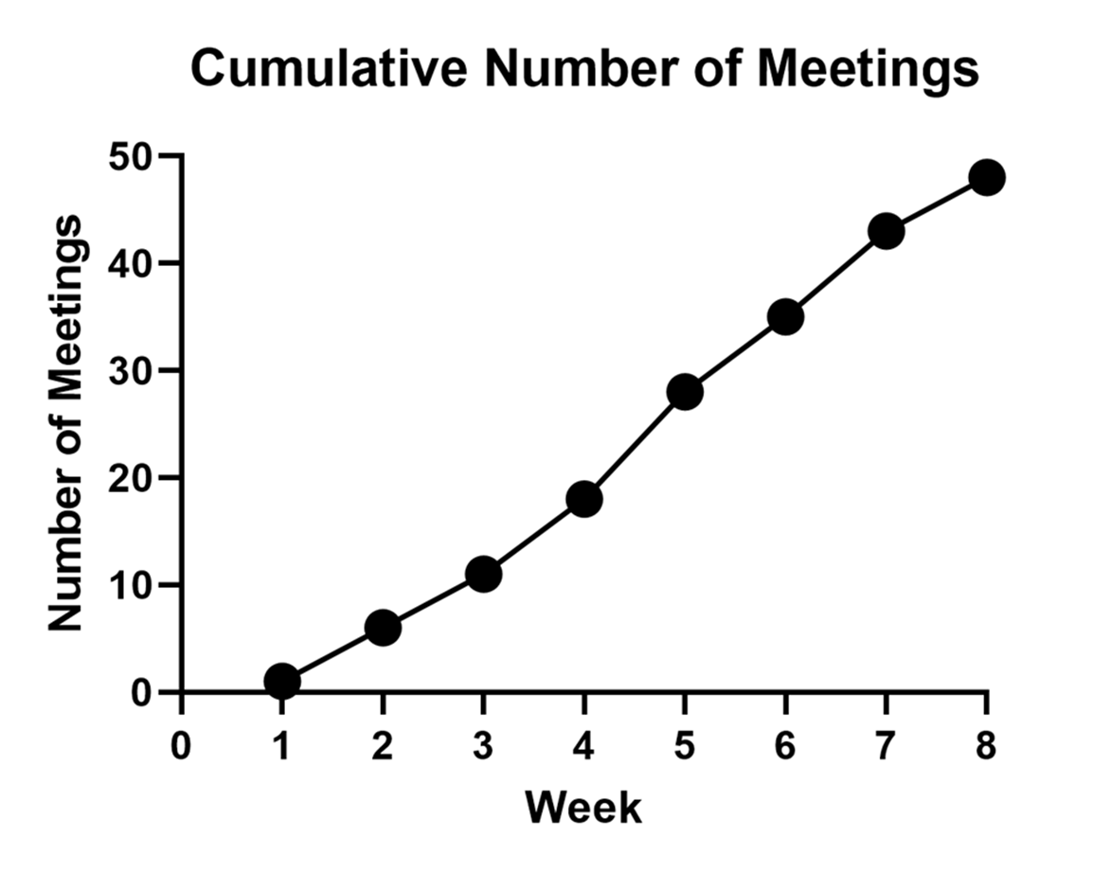

Slide 28
Data Analysis
Analysis is rooted in phenomenography, an empirically based methodology that seeks to understand by analyzing descriptions of participant experiences (Bazeley, 2013).
Cycles of coding:
  First cycle: descriptive coding (Bazeley, 2013; Saldaña, 2016)
  Second cycle: focused coding (Saldaña, 2016)
  Post-coding: trinity focusing strategy (Saldaña, 2016)

Slide 29
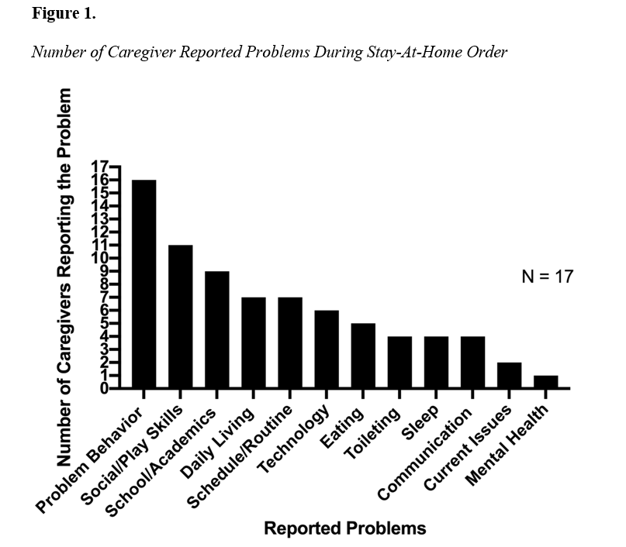
Notes:
Results: April 1 – June 1, 2020

Slide 30
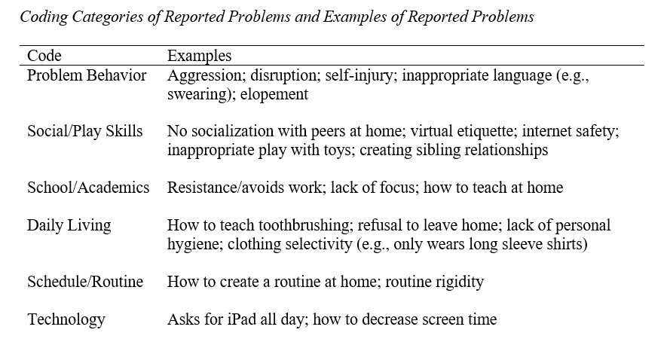

Slide 31
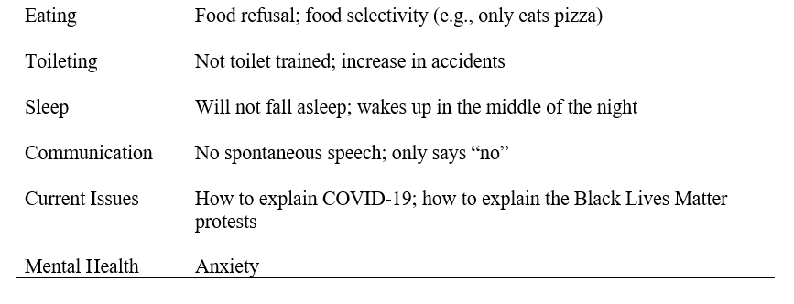

Slide 32
Types of Focused Interventions Prescribed
Differential reinforcement of alternative behavior
Visual schedules
Establishing routine
Follow through on requests
Signaled changes in activities
Signaled availability of reinforcement

Slide 33
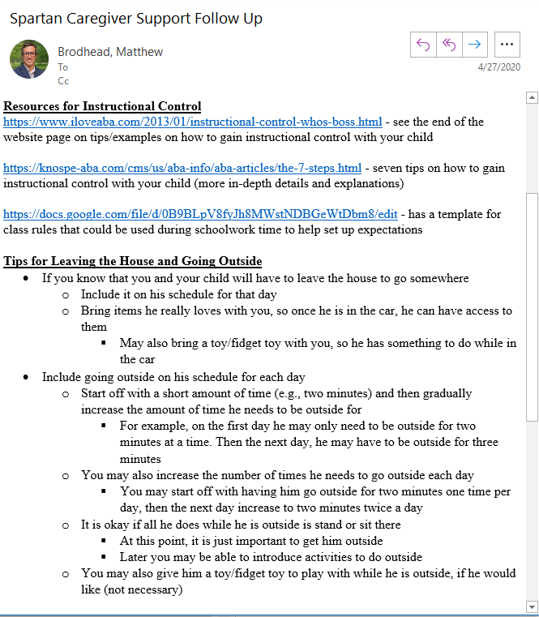

Slide 34
Case study implications

Slide 35
Primary Implication
With our program, we demonstrated a potential framework for on-demand focused support.
Similar to a brief visit to a primary care physician for an acute matter where a problem is identified and a solution is prescribed.
This kind of service delivery could solve some of the issues we have been seeing pre-pandemic, related to access to services.

Slide 36
Two Problems with Access
Problem #1: Access via geographical location
Problem #2: Access via our field’s reliance on comprehensive interventions

Slide 37
Problem #1: Access via Location
To have access to services, the system we have established has primarily privileged those with geographical location or the financial means to travel.

Slide 38
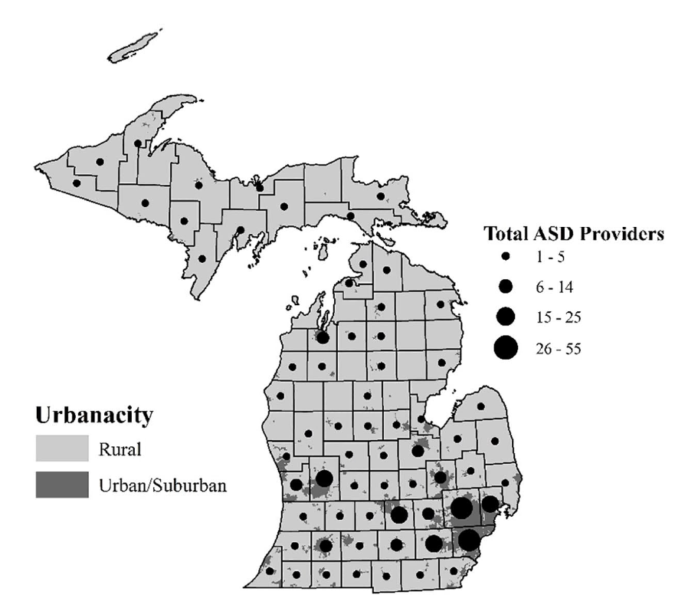
From Drahota et al. (2020).

Slide 39
Problem #2: Access via Reliance on Comprehensive Interventions
Wait-list system to receive comprehensive interventions further prevents families from accessing services.
Many children and families may not require comprehensive services, and therefore are not able to access, or do not seek, ABA services.
  These families, then, have little to no way to benefit from what we do.

Slide 40
Increase Access Overall
Addressing the before-mentioned problems will likely increases access to ABA services to people with autism and their families
  We are morally obligated to do this
    By adopting a utilitarian approach, to maximize the good while reducing the bad (Brodhead, Cox, & Quigley, 2018).
  Are we professionally obligated (e.g., via the BACB Code)?
    Most likely the answer is no

Slide 41
A call to action

Slide 42
How sad is it that it took a pandemic for our field to establish an infrastructure to provide remote and more widespread behavioral services?

Slide 43
Continue to Scale Telehealth Programs
Now that we have responded to the consumers receiving services prior to the pandemic, it is long over-due that we consider those who are currently beyond our geographical reach.

Slide 44
On-Demand Support
Develop infrastructure to support focused needs on-demand.
  This can begin with people on your waitlist.
Infrastructure may include
  Process for intake and handling needs of each call or case
  Process for oversight of on-demand support systems
  Identification of key competencies for providing on-demand support
    Supervision and training

Slide 45
Expand to Focused Treatments
Consider supporting children and families who require focused treatment in addressing specific challenges
  These children and families may not otherwise require, or pursue, comprehensive services
  This could be done via telehealth
  This could be done to expand access to more consumers because it takes less time to do this vs. comprehensive treatment
  Broaden the menu of services

Slide 46
Triaged Approach to Care
An on-demand treatment model may allow for the opportunity to identify individuals who may require more intensive or comprehensive interventions.
  This brings more consumers to our science, too!
By standardizing operating procedures, the professional may instead recommend an in-home or center-based consultation to better support the person with autism and their family.

Slide 47
A Commitment to the Future
Don’t ever forget the urgency to problem solve and generate solutions to complex problems that we all faced last March.
Carry that commitment and innovation forward, post-pandemic, to help people with autism, and their families, realize a better future.

Slide 48
/ralk
Questions?
Contact Dr. Matt Brodhead for more information
  mtb@msu.edu
Visit www.mattbrodhead.com for a copy of this presentation, references, and additional materials!

